Slide 1




A Crash-Course into
Exploratory Data Analysis (EDA)
Join our Slack:
Sign-in:
go.osu.edu/BDAAsignin
go.osu.edu/bdaaslack
Notes:
Clear kernel & delete ".html" before class

Slide 2
Zoom Etiquette & Code of Conduct
Please keep your mic on mute unless talking
Questions are welcome and encouraged at any time! Just please ask in the chat during the presentation
This meeting will be recorded and posted publicly later. By continuing to be in this workshop, you consent to this recording and its publication
BDAA aspires to create a community built on collaboration, innovation, creativity, and belonging within and across disciplines. To inspire, empower, and connect all members -- whatever race, gender, age, ethnicity, cultural heritage or nationality; religious or political beliefs; sexual orientation or gender identity; or socioeconomic, veteran or ability status -- BDAA is committed to an intersectional, persistent, and self-aware movement towards equal opportunity.
By participating in this workshop, you agree to abide by our code of conduct in support of these values (bdaaosu.org/conduct/)

Slide 3
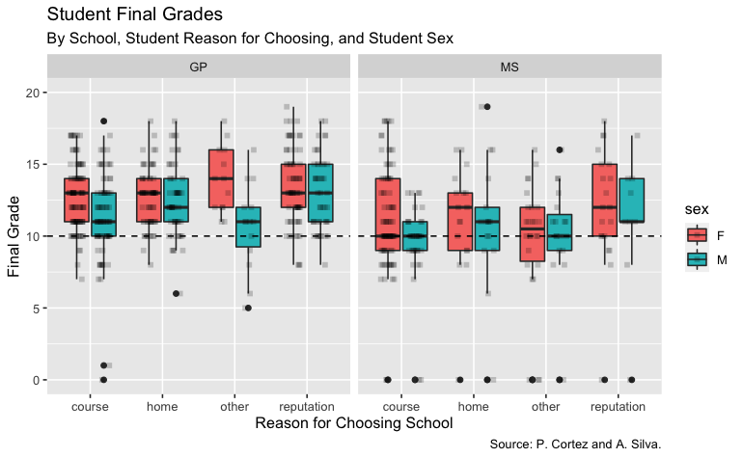
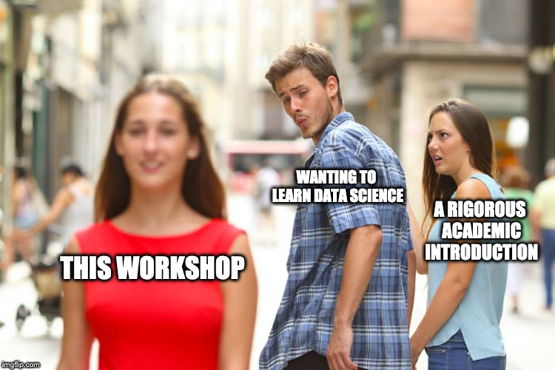
Today We Will...
Learn what EDA is
Perform EDA on a real dataset
Run our first R program
Code our own graphs
Discover insights about the data

Slide 4




Who am I?
Leo Glowacki (he/him/his)
5th Year
Major: Data Analytics and Music
BDAA Education Director
Certified RStudio Instructor
Dogs > Cats

Slide 5


3 Min Intro Breakout Rooms
Name
Major
Year
Where are you from?
Cats or dogs? (Or something else??)
Why?

Slide 6

Exploratory Data Analysis (EDA)
What is EDA?
approach, not a specific set of techniques, about how data analysis should be carried out
primarily graphical, not many quantitative techniques
strives to:
maximize insight into a data set;
uncover underlying structure;
extract important variables;
detect outliers and anomalies;
test underlying assumptions;
develop parsimonious models; and
determine optimal factor settings.

Slide 7
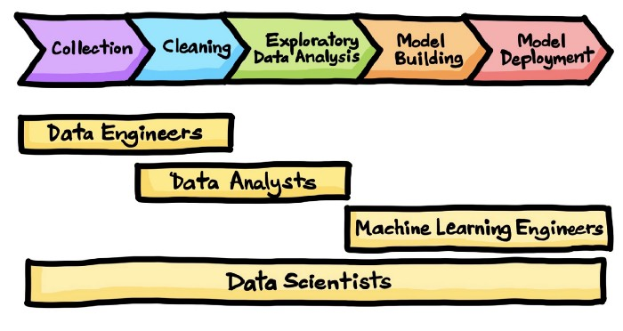
The Data Science Process
(Drawn by Chanin Nantasenamat in collaboration with Ken Jee)
Notes:
Why do we do EDA?
When does it occur?

Slide 8
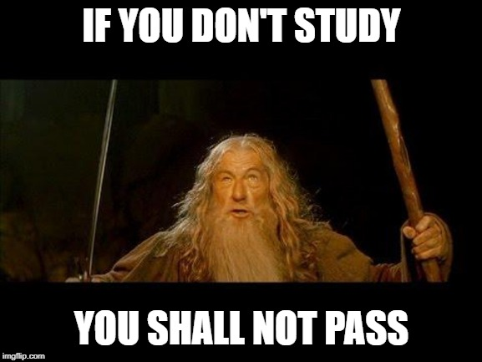
Tonight's Dataset
https://archive.ics.uci.edu/ml/datasets/Student+Performance
Data from 2 public schools in Portugal (2005-2006 school year)
High student failure rates - esp. in Math and Portuguese
Paulo Cortez and Alice Silva
"Using Data Mining to Predict Secondary School Student Performance"
Is it possible to predict student performance?
What are the factors that affect student performance?
Notes:
discuss variables

Slide 9

Run Your First R Code
Go to this link: https://go.osu.edu/bdaa_eda_code
Sign in or create account
Join Space
Click "Projects" at the top
Select the "Bootcamp" Project
Wait for project to deploy
Select "EDA_Workshop.Rmd" (bottom right)
Click "Knit" (top left, blue yarn ball icon)
Notes:
R is a programming language
You can program R in RStudio/RStudio Cloud
Name parts in RStudio
Knitting gets your results
Load times- be patient, don't refresh
Ensure no pop up blockers preventing RMarkdown
MAKE OWN COPY

Slide 10

Your Turn
Change the code in the first block to make a boxplot with:
Mjob (mother's job) on the x-axis,
G3 (final grade) on the y-axis, and
address as fill
Discuss what you see with your neighbor
Any patterns?
Anything else you'd like to see or try
Notes:
Don't worry about understanding all the code now, just focus on the task

Slide 11
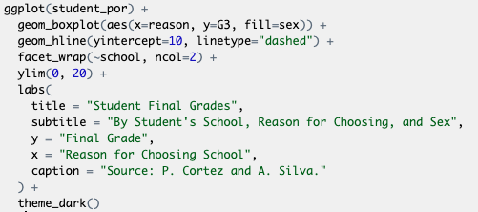
How did we do it?

Slide 12
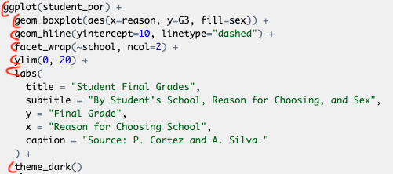
How did we do it?
Plots consist of layers
Notes:
Each line-ish is a layer

Slide 13
How did we do it?
Plots consist of layers
1st layer: Data

Slide 14
How did we do it?
Plots consist of layers
1st layer: Data
2nd layer: geom_function and aesthetic values

Slide 15
How did we do it?
Plots consist of layers
1st layer: Data
2nd layer: geom_function and aesthetic values
The rest is extra

Slide 16
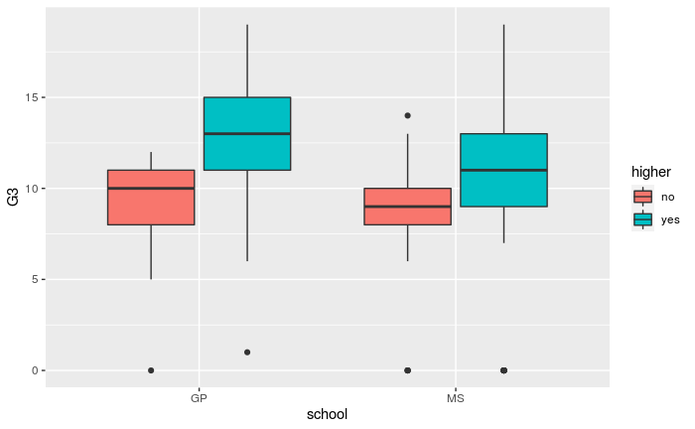
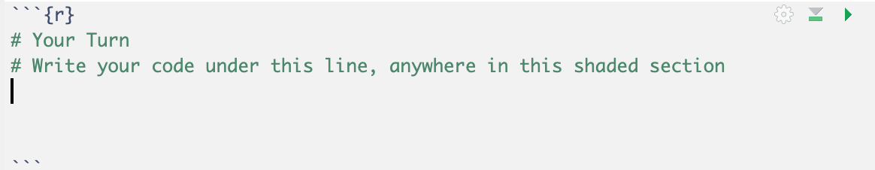
Your Turn
Make a boxplot with:
school on the x-axis,
G3 (final grade) on the y-axis, and
higher (if the student wants to take higher education) as fill
Use the lowest code block to do so
Discuss what you see with your neighbor

Slide 17
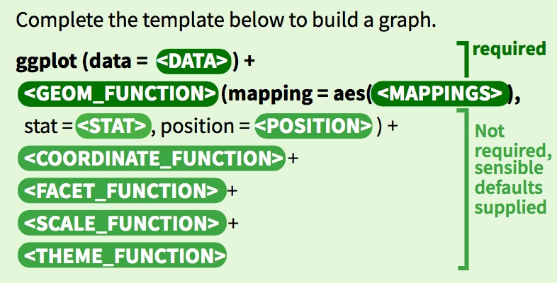
You Can Make Any Graph with This Formula

Slide 18
You Can Make Any Graph with This Formula

Slide 19

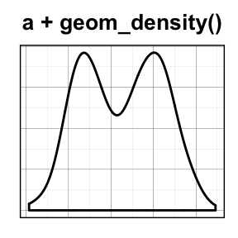
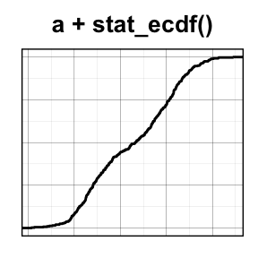
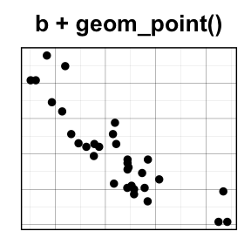
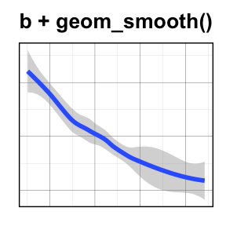
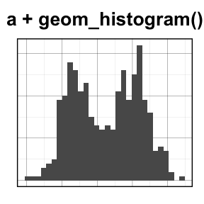
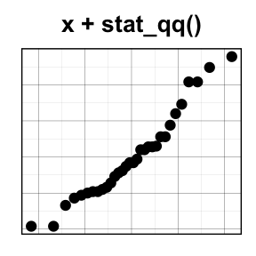
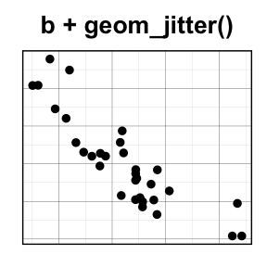
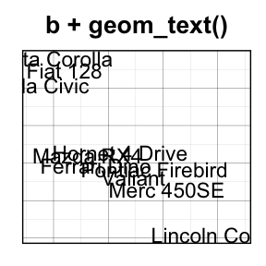
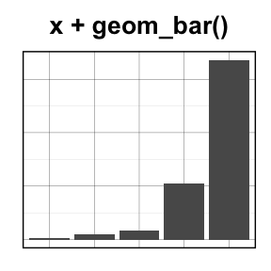
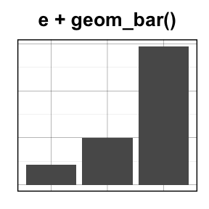
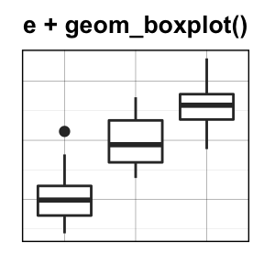
One Variable
Two Variables
X Continuous
X & Y Continuous
X Discrete
X Disc., Y Cont.
http://www.sthda.com/english/wiki/be-awesome-in-ggplot2-a-practical-guide-to-be-highly-effective-r-software-and-data-visualization

Slide 20

Questions?
Any Questions?
BDAA Slack R Learning Community!
go.osu.edu/bdaaslack
Feedback:
go.osu.edu/eda_survey
My Contact Info:
Leo Glowacki
Message me on Slack!
www.LeoGlowacki.com

Slide 21
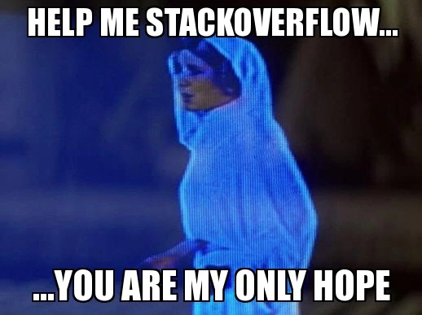
Further Resources
Getting started with R: https://rstudio.cloud/learn/primers
ggplot Cheatsheet: https://ggplot2.tidyverse.org/#cheatsheet
R for Data Science Book: https://r4ds.had.co.nz/
Top 50 ggplot Visualizations: http://r-statistics.co/Top50-Ggplot2-Visualizations-MasterList-R-Code.html

